Slide 1

C103 Videos W11 10/30/23
Honda Best Friends ad

Slide 2
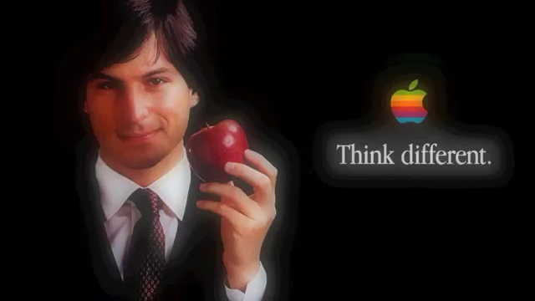
Apple “Think Different” ad

Slide 3

Nike “Chainsaw Massacre” ad

Slide 4
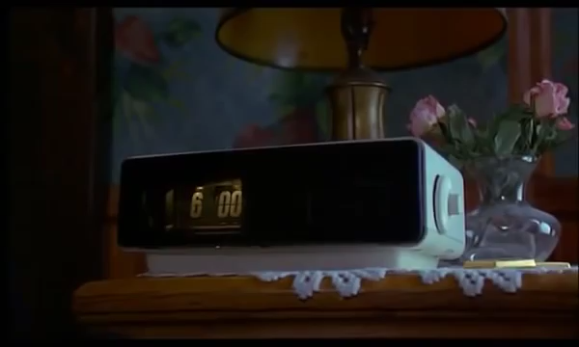
Groundhog Day

